Slide 1
Title: Housing Price Dashboard – Dubai
By Shruti Sumadhur Ghosh

Slide 2
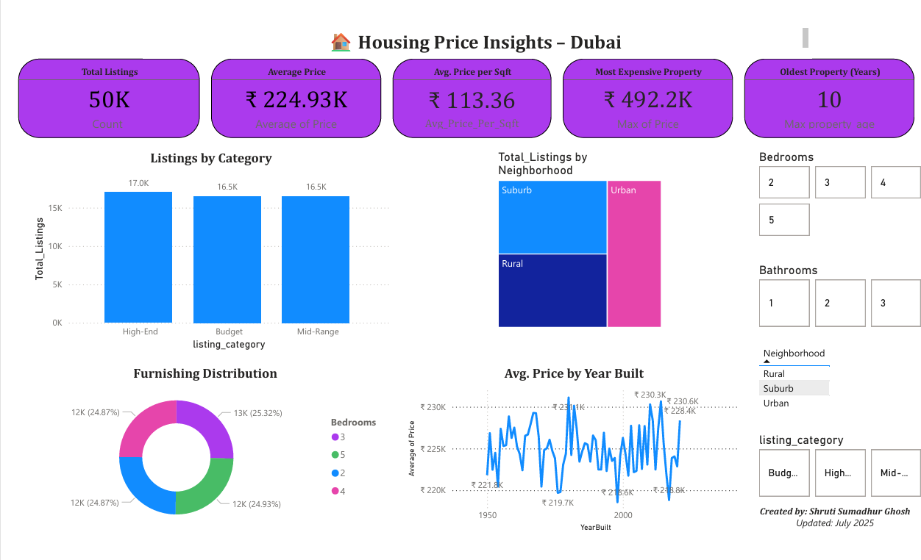

Slide 3
📊 Dubai Housing Price Dashboard
📍 Objective: Analyze 50,000+ real estate listings in Dubai to understand price trends by location, property type, and size.
🛠 Tools Used:
Microsoft Excel (data cleaning)
Power Query & Power BI (modeling & visualization)
DAX (for calculated fields & categories)
📊 Key Features:
KPI cards for total listings, avg. price, price per sqft
Interactive slicers for bedrooms, bathrooms, location
Charts: bar, donut, line, and tree map
DAX-based classification into Budget, Mid-Range, High-End
👩‍💻 Created by: Shruti Sumadhur Ghosh 📅 July 2025

